Slide 1


Chapter 2: The Power of Positive Thinking
By Group 2:
Nidhishree Sanam
Shwetha Reddy Reddymalli
Sai Gangadhar Veeramreddy
Sai Manoj Kalasani
Sravani Ravulaparthi

Slide 2

Characters in the story
Story Recap
Ben comes to Stanley’s office and enquired regarding the overhead pipes' installation in Building B and the insulating material applied.
Stanley uses Insuban, the best stuff he could find, instead of Expandrium for the insulation of the pipes which made Ben furious.
Ted Shelby announced that Mr. Marsh would be touring the now-finished Building B to mark the official opening of the B Building facility.
Marsh, Ted Shelby, board members, and Stanley were touring the Building B when one of the board member says “Isn’t that Expandrium insulation? I don’t believe I’ve seen that application before.”
In reply Stanley politely says “Well, sir, it’s always been our material of choice in the Company. We see it this way – when your own outﬁt makes the best product, you go with it.”
Mr. Marsh impressed with Stanley's explanation turns to Ted and says, "Good show, Ted. You know, I wish more of our people would understand, like young what's his name there does, that every one of us is a salesman for The Company."
Stanley – Assistant Plant Engineer
Ben Franklyn – Senior Employee
Marsh – CEO of the Organization
Ted Shelby – Staff Assistant of CEO

Slide 3
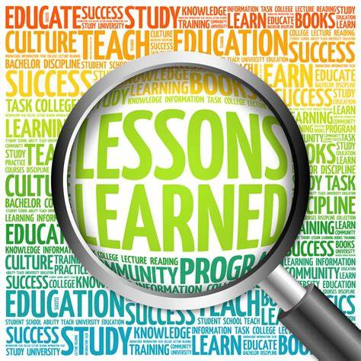
Managerial Lessons learned
Every problem has a solution. Problem complexity totally depends on the perspective of thinking.
Predict rather than being uncertain of not doing anything.
Practice before you preach.
Believe in yourself and visualize your goals to see how small your problems are.
Imagine your life free of worry to become less concerned about the future.
Your attitude determines your entire life.

Slide 4
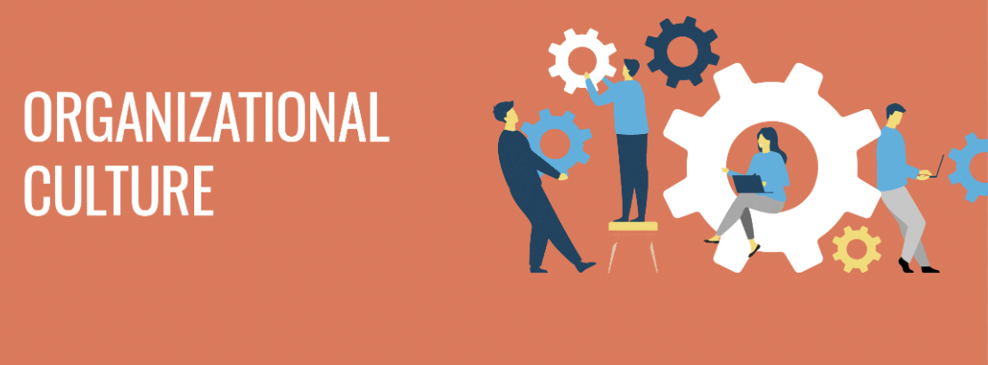
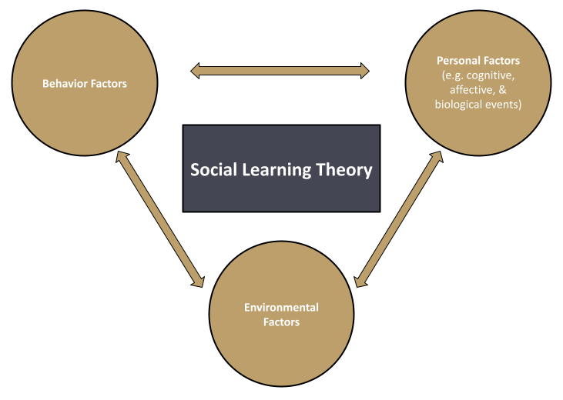
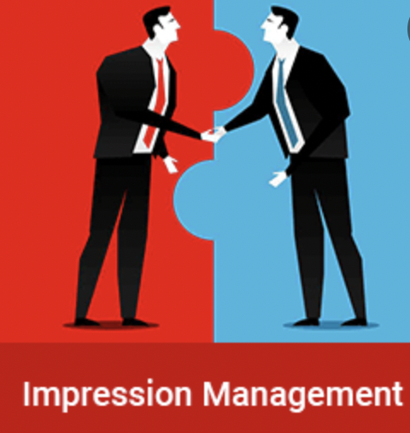
Theories
Organization Culture
Shared views, values, and attitudes developed by leaders within the organization defines organizational culture, which in turn shapes how employees behave and perceive in the organization.
Social Learning Theory
Social learning theory considers how environmental and cognitive factors interact to influence human learning and behavior.
Impression Management
Impression management is a conscious or subconscious process in which people attempt to influence the perceptions of other people or object by controlling information in social interaction.

Slide 5


Additional Research
Apple Inc. has an organizational culture for creative innovation. The company’s cultural features focus on maintaining a high level of innovation that involves workers’ creativity and a mindset that challenges conventions and standards, such as in the area of consumer electronics design. The business depends on cultural support and coherence, which are determinants of competitiveness and industry leadership, especially in addressing aggressive and rapid technological innovation and product development. The following are the main characteristics of Apple’s corporate culture:
The following are the main characteristics of Apple’s corporate culture:
Top-notch excellence
Creativity
Innovation
Secrecy
Moderate combativeness
Apollo has an organizational culture for Hospitality. In the case of Apollo Hospitals Differentiation through Hospitality, the company promotes a professional attitude among its employees. There is no obligation to behave in a particular way. At Apollo Hospitals Differentiation through Hospitality, diversity is promoted, and differences are appreciated. It is done to leverage the opportunities offered by such constructive differences. It shows the importance of cultivating a professional organizational culture to remain successful in a highly diversified environment.
open door policy
office layout
official dress code for the employees

Slide 6

References:
https://positivepsychology.com/social-learning-theory-bandura/
https://panmore.com/apple-inc-organizational-culture-features-implications
https://www.essay48.com/case/19634-Apollo-Hospitals-Differentiation-through-Hospitality-Organizational-Culture
The ropes to skip and the ropes to know_ studies in organizational theory and behavior-Chicago Business Press

